Slide 1
ACEM LECTURE LANDSLIDE RISK ASSESSMENT
C. T. TOH
DR TOH ASSOCIATES SDN BHD

Slide 2
PRESENT MALAYSIAN PRACTICE FOR DESIGN OF CUT SLOPE
1. Select Factor of safety. Usually 1.4.
2. Carry out a few boreholes. Get an idea of c’ and φ’ and ground water.
3. Unless existing cut slope, assume circular failure mechanism.
4. Use a limit equilibrium method. Calculate the Factor of safety.
5. The end result is very similar to all designers and all situations. 1v :1h or 1v:1.5h batters with or without horizontal drains to lower ground water. Steeper slopes will require soil nails

Slide 3
UNCERTAIN AND DEFICIENCIES OF PRESENT DESIGN PROCEDURE
Blind following of Hong Kong GCO Factor of Safety established in a data rich environment
No attention given to HKGCO caveats to risk of life and economic loss that warrants higher FS
Arbitrary reduction of FS to 1.2 for temporary slopes without due regard to consequence to life and economic loss over the shorter duration. Based on a misplaced logic that one can predict the slope performance over shorter durations

Slide 4
UNCERTAINTIES AND DEFICIENCIES OF PRESENT DESIGN PROCEDURE
Orientations of relict discontinuities given little attention.
Often no or insufficient mapping of slope during excavation to validate the circular slip model.
Unlike basement excavations, slope monitoring using inclinometers and piezometers.

Slide 5
MODEL OF NATURE
“NO MATTER THE LEVEL OF INVESTIGATIONS, A MODEL OF NATURE IS BY DEFINITION INADEQUATE”.
THE QUESTION THEN BECOMES ONE OF ASSESSING THE CONSEQUENCE OF MODEL INADEQUACY.
THIS IS OFTEN NOT DONE

Slide 6
IS SLOPE STABILITY A PREDICTIVE TOOL?
Morgenstern (1997) “ Landslide valuation problem is dominated by uncertainty, whether it be a natural slope or an excavation. Uncertainty arises at all stages in the resolution of the problem, from site characterization to material property, through to consequence assessment”

Slide 7
IS SLOPE STABILITY A PREDICTIVE TOOL?
LLM TRIALS – embankment on soft clay. Homogeneous conditions. High quality comprehensive data. Predictions ranged from 52% to 176% of the correct answer. 55% of the predictions were considered poor to bad.
In the light of uncertainties and deficiencies, the standard method of design cannot be considered a predictive tool. Rather it is a design tool that if applied judiciously and wisely will in most instances result in satisfactory performance. However slope failures will occur now and then, sometimes with disastrous consequence.
Nature is seldom benign

Slide 8
EVOLUTION OF CUT SLOPE ANGLES
Before 1975, cut slope angles tanged up to 60 degrees. KL – Karak Highway completed before 1975. By 1978 severe erosion and number of slope failures had taken place resulting in a need to stabilize the slopes.
North South Highway early 1980s. Most of the slopes were cut to 1v : 1h. Over time several slope failures had taken place,
Over the last 10 to 15 years, almost always slopes were cut to 1v : 1.5 h

Slide 9
REASONS FOR LANDSLIDE RISK ASSESSMENT
Present method of slope design that involves stability analysis only is inadequate and with deficiencies especially given the uncertainties associated with ground water, weathering profiles and geological discontinuities.
Therefore enhanced methods of assessment with due consideration given to identifying risk and consequence are necessary.
Over last 15 to 20 years, Risk assessment increasingly be adopted in places like Hog Kong, Australia, Canada, France and Italy.

Slide 10
REASONS FOR RISK BASED ANALYSIS. Ho (2007)
Geotechnical failures are not a rarity and sometimes disastrous
Conventional stability analysis with traditional factors of safety are not always capable of averting undesirable performance (Morgenstern 1991)
Over designing costs money
Excessive use of Codes of Practice can result in unsatisfactory performance if used by the inexperienced. For example over-conservative assessment of slopes could prohibit development resulting in reduction in land values and raise fears regarding the integrity of existing developments while lack recognition of potential failures could result in dire consequence

Slide 11
LANDSLIDE RISK MANAGEMENT
SLOPE ENGINEERING (AND OTHER ASPECTS OF ENGINEERING) OFTEN INVOLVES JUDGEMENT IN AN INFORMAL MANNER. LANDSLIDE RISK MANAGEMENT IS A STRUCTURED APPROACH SUPPORTED BY HISTORICAL RECORDS BUT BASED ON THE KEY FACTORS THAT DETERMINE LANDSLIDE DAMAGE:
NATURE OF LIKELY GROUND MOVEMENT
NATURE AND VALUE OF ASSETS AND ELEMENTS AT RISK
VULNERABILITY TO THE MOVEMENTS
EXTENT OF EXPOSURE

Slide 12
RISK MANAGEMENT PROCESS
3 COMPONENTS
PROCESS INVOLVES ANSWERING THE FOLLOWING QUESTIONS
RISK ANALYSIS
RISK EVALUATION
RISK TREATMENT
WHAT MIGHT HAPPEN?
HOW LIKELY IS IT?
WHAT DAMAGE OR INJURY MAY RESULT?
WHAT CAN BE DONE ABOUT IT?

Slide 13
DEFINITIONS
RISK The likelihood of specified consequences arising from an event, circumstance or action
…… within a stated period and area.
HAZARD
Potential for adverse consequences of some event ….
VULNERABILITY Potential to suffer harm, loss or detriment. The reverse of robustness and durability

Slide 14
ADVERSE CONSEQUENCE TO A PARTICULAR ASSET FROM A HAZARD EVENT
Hazard event x Vulnerability = Adverse consequences
H x (E x V) = C
H = specific hazard event (landslide)
E = Total value of elements at risk (property)
V = vulnerability (proportion of E) e.g. vulnerability of timber structure compared to rc structure
C = adverse consequence

Slide 15
Adverse consequence from proportion of time. moving person or vehicle
H x ( E x V x E_{x}) = C
H = specific hazard event
E = Max potential value of elements at risk
V = vulnerability (proportion of E)
Ex = Proportion of E likely to be present at time of event and therefore susceptible to be impacted. Exposure
C = adverse consequence

Slide 16
RISK
R_{s} = Pr(H_{i}) x (E x V x E_{x} )
R_{s} = Specific risk or expected loss due to particular magnitude of landslide H_{i} Pr(H_{i}) = Probability of a particular magnitude of landslide H_{i}
E = total value of elements at risk threatened by landslide – fixed assets and mobile assets
V = vulnerability or proportion of E likely to be affected detrimentally (scale 0 to 1)
Ex = exposure or the proportion of total value likely to be present and therefore susceptible to be impacted (Scale 0 to 1)

Slide 17
SUMMATION OF RISKS
TOTAL RISK R IS SUM OF CALCULATION OF SPECIFIC RISK
R = Σ R_{s} ( landslide events 1….. n)

Slide 18
RISK AND UNCERTAINTY
ESTIMATION OF RISK REQUIRES
ESTIMATION OF FREQUENCY AND MAGNITUDE OF FUTURE LANDSLIDE
LIKELY CONSEQUENCE ARISING FROM EACH EVENT

Slide 19
LANDSLIDE RISK MANAGEMENT CONCEPT AND GUIDELINES
“LANDSLIDE RISK MANAGEMENT CONCEPTS AND GUIDELINES”. AUSTRALIAN GEOMECHANICS SOCIETY. SUB COMMITTEE ON LANDSLIDE RISK MANAGEMENT1997
LANDSLIDE RISK ASSESSMENT E.M. Lee & D.K.C. Jones Thomas Telford

Slide 20
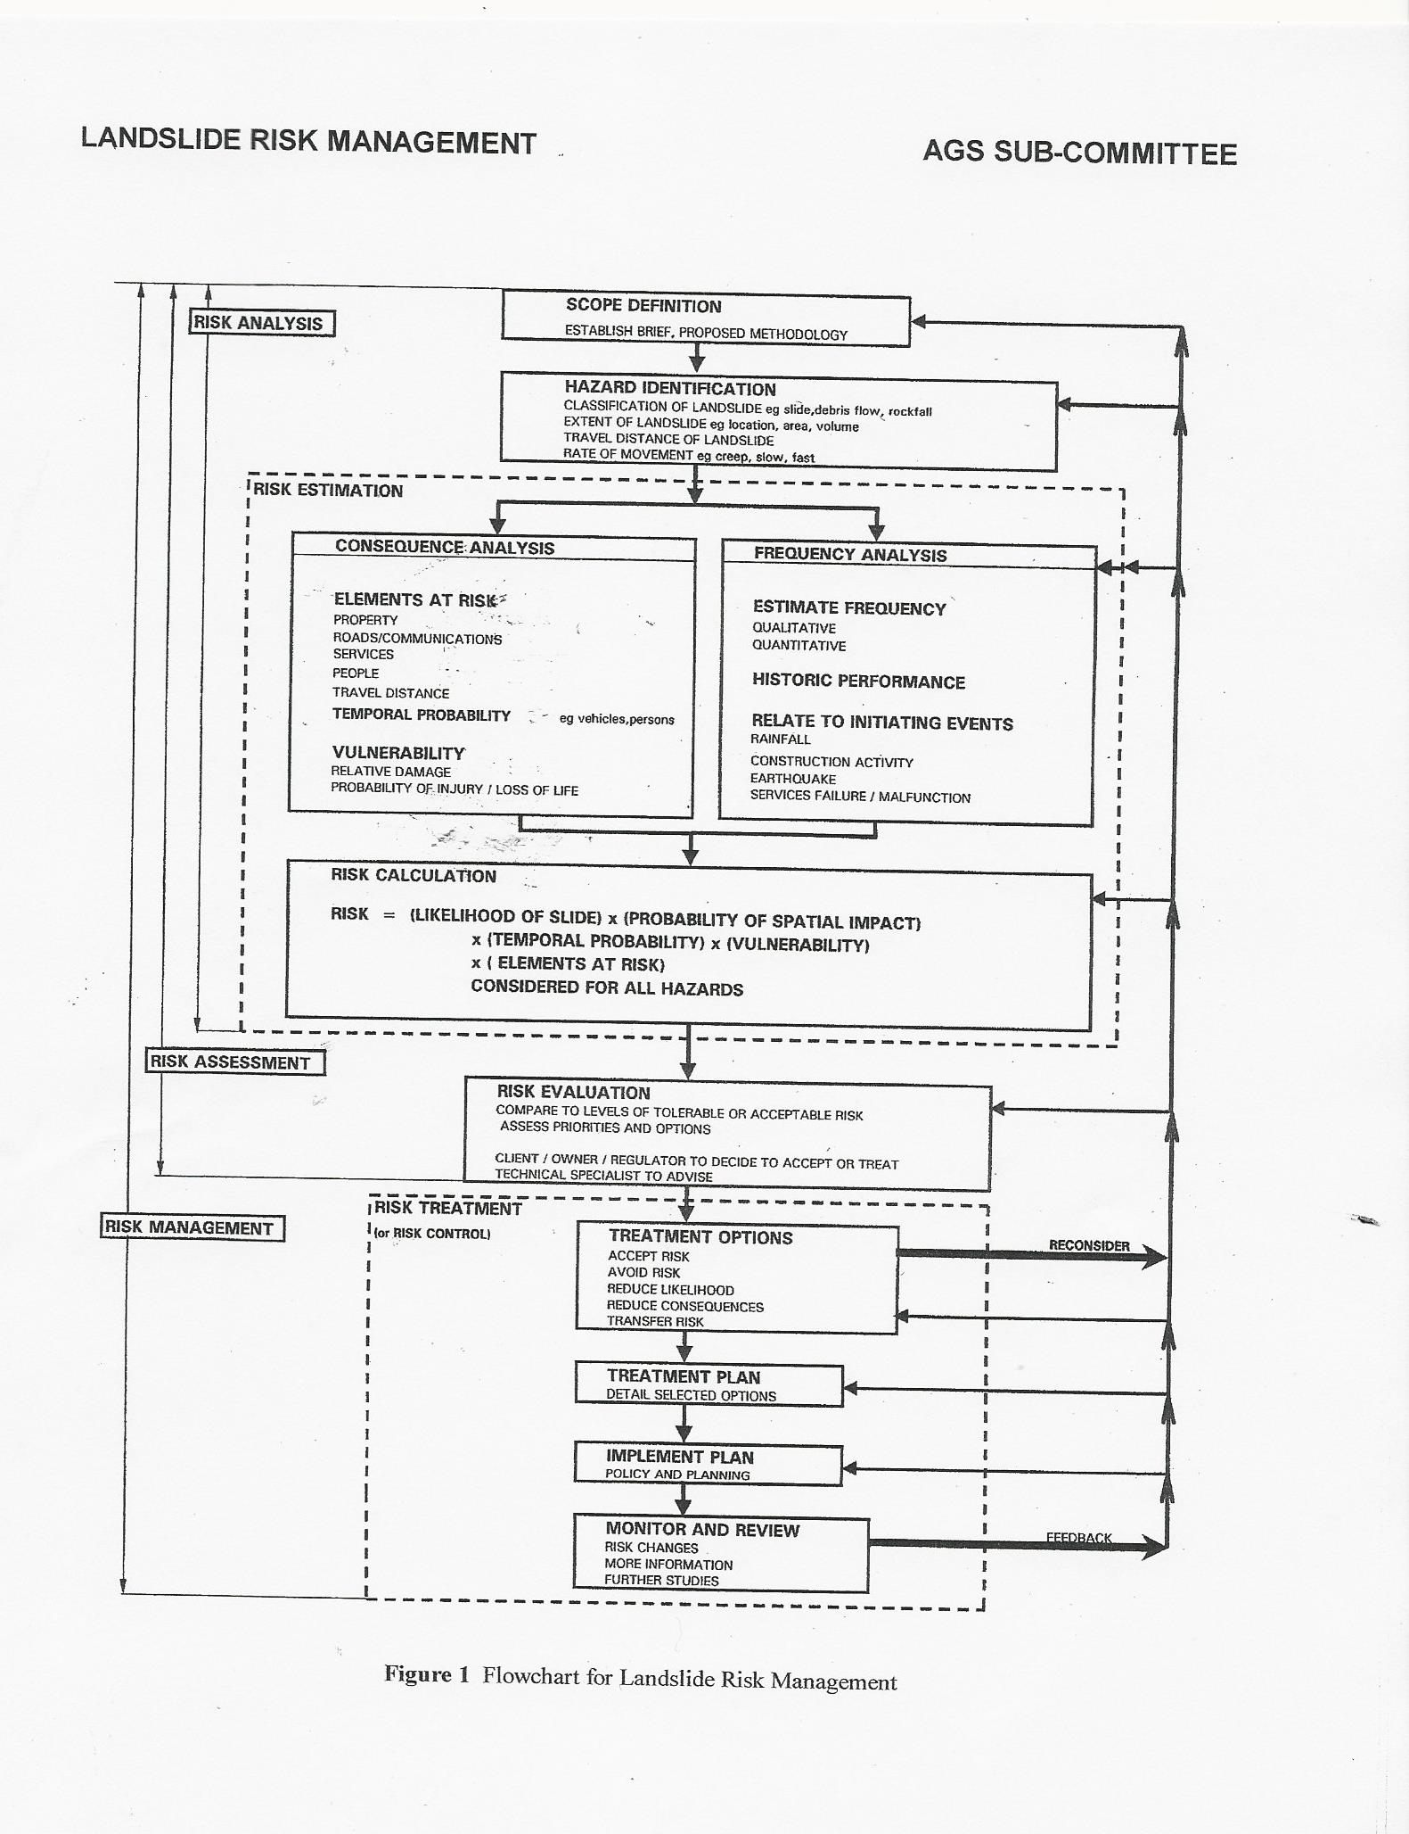

Slide 21
INVOLVEMENT OF ALL PARTIES
The Guidelines state It is important to recognize that part of the process involves comparing the assessed risks (of property loss and damage, and loss of life) against acceptance criteria. It is recommended that this comparison be carried out with the involvement of the client, owner and regulators

Slide 22
HAZARD IDENTIFICATION

Slide 23
HAZARD IDENTIFICATION

Slide 24
HAZARD IDENTIFICATION
CLASSIFICATION OF LANDSLIDE e.g. slide, debris flow, rock fall
EXTENT OF LANDSLIDE e.g. Location, area, volume
TRAVEL DISTANCE OF LANDSLIDE
RATE OF MOVEMENT e.g. creep, slow, fast
Lee and Jones pp51 It is the presence or absence of pre-existing shear surfaces or zones (READ RELICT JOINTS) within a slope that control the character of the landslide activity

Slide 25
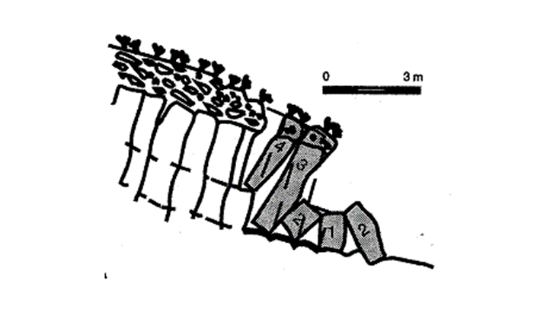
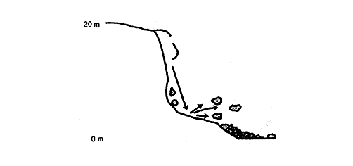
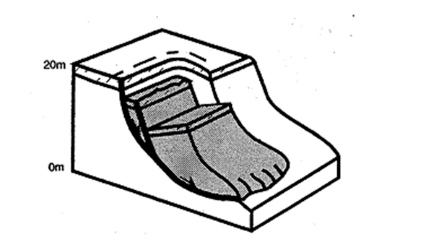
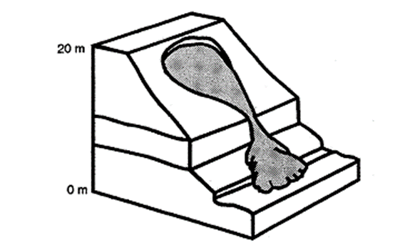
CLASSIFICATION

Slide 26
HAZARD IDENTIFICATION
The distance the slide will travel and its velocity determine the extent to which the landslide will affect property and people downslope, and their ability to escape. Key factors that determine that influence the travel distance (Ong and Ho, 1996): (i) Slope characteristics – materials , geological structures and geometry (ii) Failure mechanism (iii) Conditions of downhill slope

Slide 27
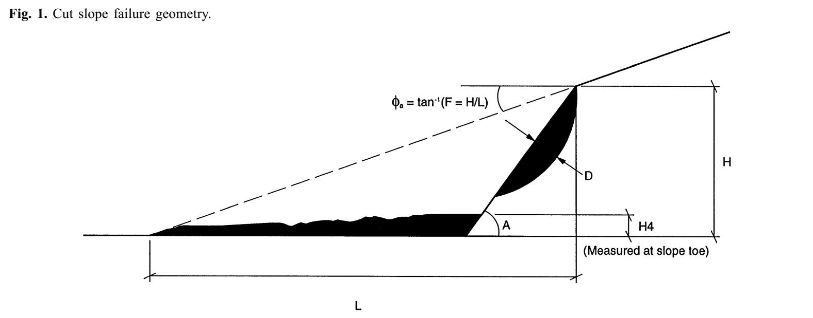
FINLAY – MODEL FOR RUN OFF DISTANCE

Slide 28
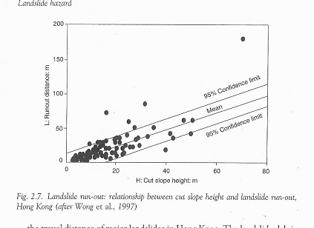
RUN OFF DISTANCE vs CUT SLOPE HEIGHT
20m high slope.
Expect L = 20m (mean) or L=40m (95% confidence limit
GRANITO – 28.5M HIGH TRAVEL DISTANCE 60M

Slide 29
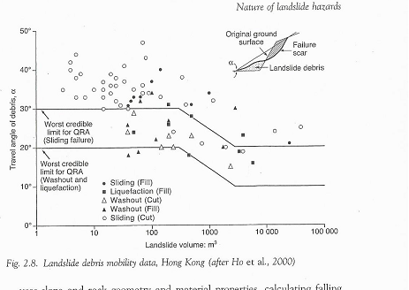
TRAVEL DISTANCE – VOLUME (Hong Kong)
GRANITO ANGLE = 25 degrees VOL = 20,520 CU M HIGH END OF HONG KONG DATA

Slide 30
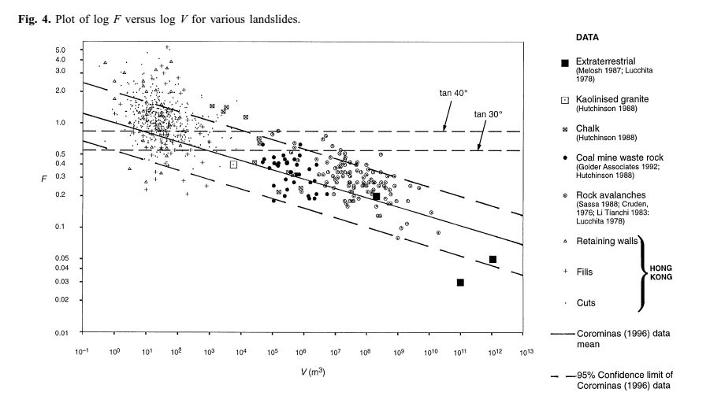
FINLAY – PhD thesis. F = H/L versus volume
Grainto Vol = 20,520 F = H/L = 0.48

Slide 31
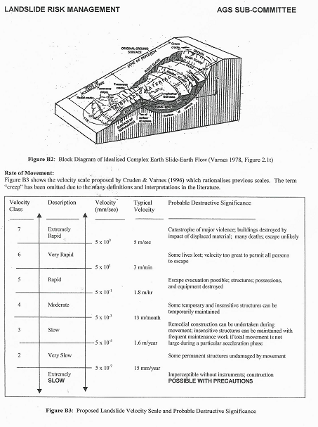
SPEED CLASSIFICATION
5 M / SEC = FAST RUNNING

Slide 32
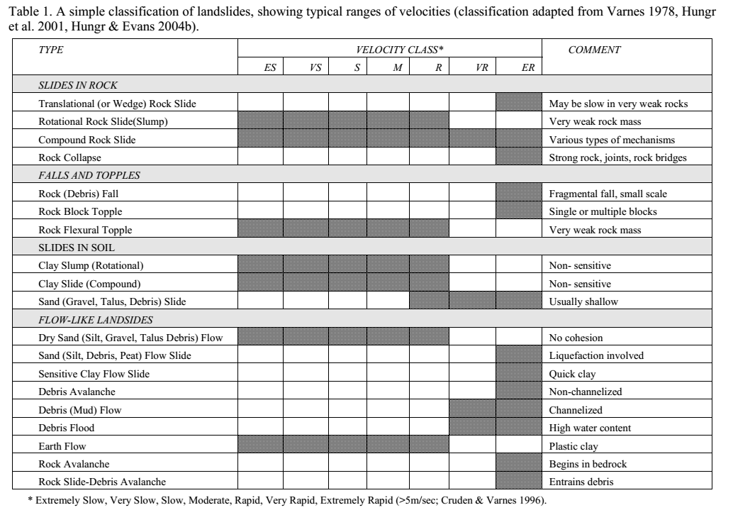
LANSLIDE TYPE VELOCITY

Slide 33
FREQUENCY ANALYSIS

Slide 35
FREQUENCY ANALYSIS - Historical data Hong Kong wide annual probability
ESTIMATE FREQUENCY FROM HISTORICAL DATA
HONG KONG. 10 YEAR PERIOD. 1984 TO 1993. Total cut slopes = 20,500 Failures = 2,177 Annual probability of failure (Hong Kong wide) = Number historical events / Total number cut slope = 2177 / 20,500 = 0.016 No differentiation based on site conditions

Slide 36
FREQUENCY – HISTORICAL DATA Hong Kong site specific (Fell)
Use of site related factors: Probability of failure (particular slope) = Probability of failure Hong Kong wide x Adjustment Factor F
Slope less likely than average to fail F < 1
Slope more likely than average to fail F > 1
F = F’ x Fe F’ = primary site factor F’1 x F’2 x F’3 x F’4 x F’5 Fe = History of instability at the site

Slide 38
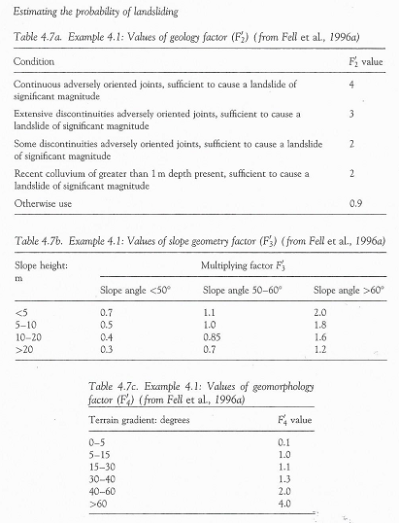
F2’ Geology factors
F3’ Slope geometry factors
F4’ Terrain gradient

Slide 39
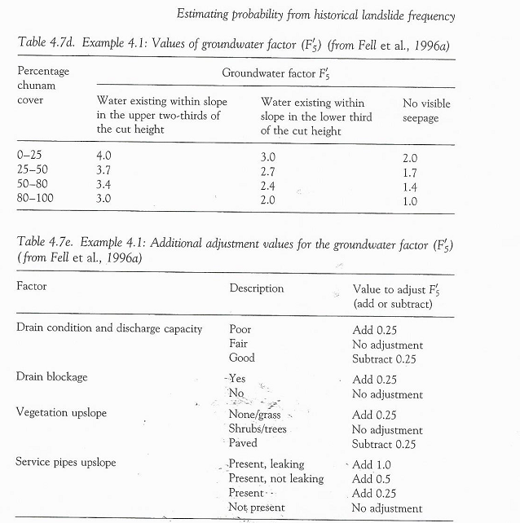
F5’ ground water

Slide 40
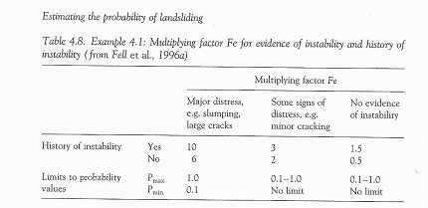
Fe History of instability

Slide 41
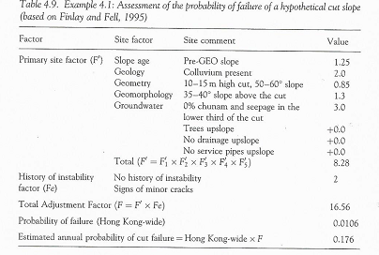
EXAMPLE

Slide 42
FREQUENCY ANALYSIS - PROBABILITY BASED ON RAINFALL AS INITIATING EVENTS
CONDITIONAL PROBABILTIES
Prob (Landslide) = Prob (Rainfall) x Prob(Landslide I Rainfall) Prob (Rainfall) = Probability of a certain magnitude of rainfall Prob (Landside I Rainfall) = Probability of landslide given the probability of rainfall of that magnitude
Also requires massive historical data. You need data on rainfall as well as data of failure for the different rainfalls.

Slide 43
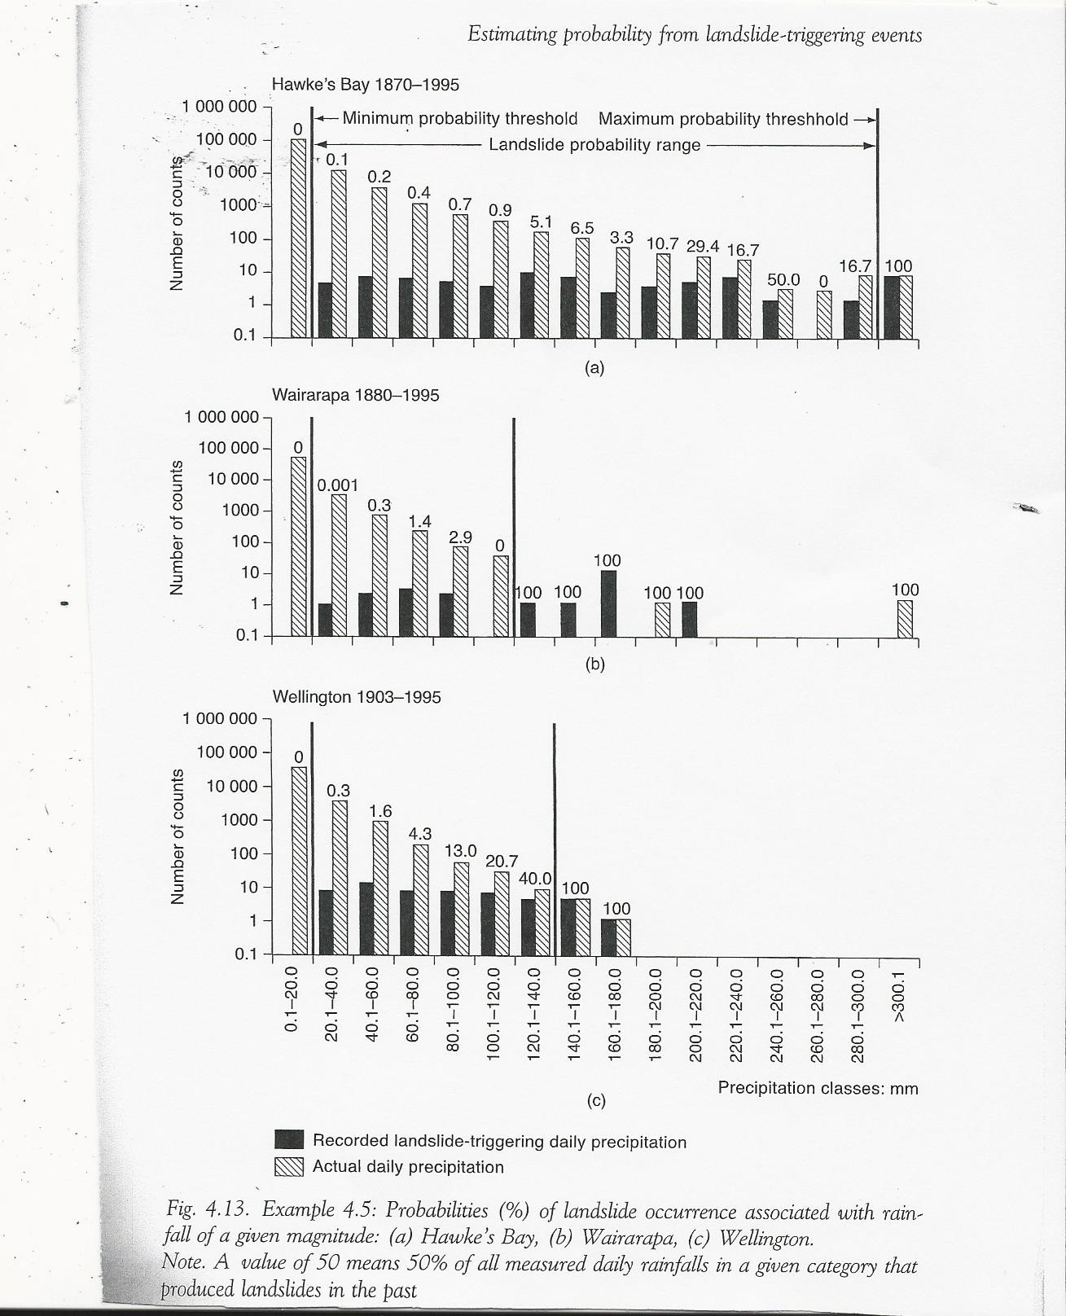
RAINFALL NZ records up to 120 years of record
For every interval of daily rainfall, Number is the % of measured rainfall that produced a landslide. Min and max probability thresholds that (i) No slope failures for all the rainfall counts. Pr = 0
(ii) Every (100%) one of the rainfall counts within the range resulted in a slope failure. Pr = 100%

Slide 44
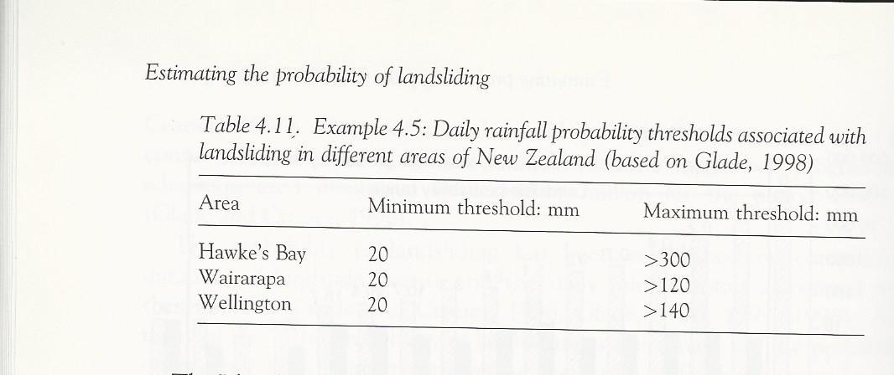
NZ RAINFALL MINIMUM AND MAXIMUM THRESHOLD VALUES

Slide 45
CONDITIONAL PROBABILITY
Pr (landsliding) = Pr (Triggering event) x Pr (Landslide I Triggering event)

Slide 46
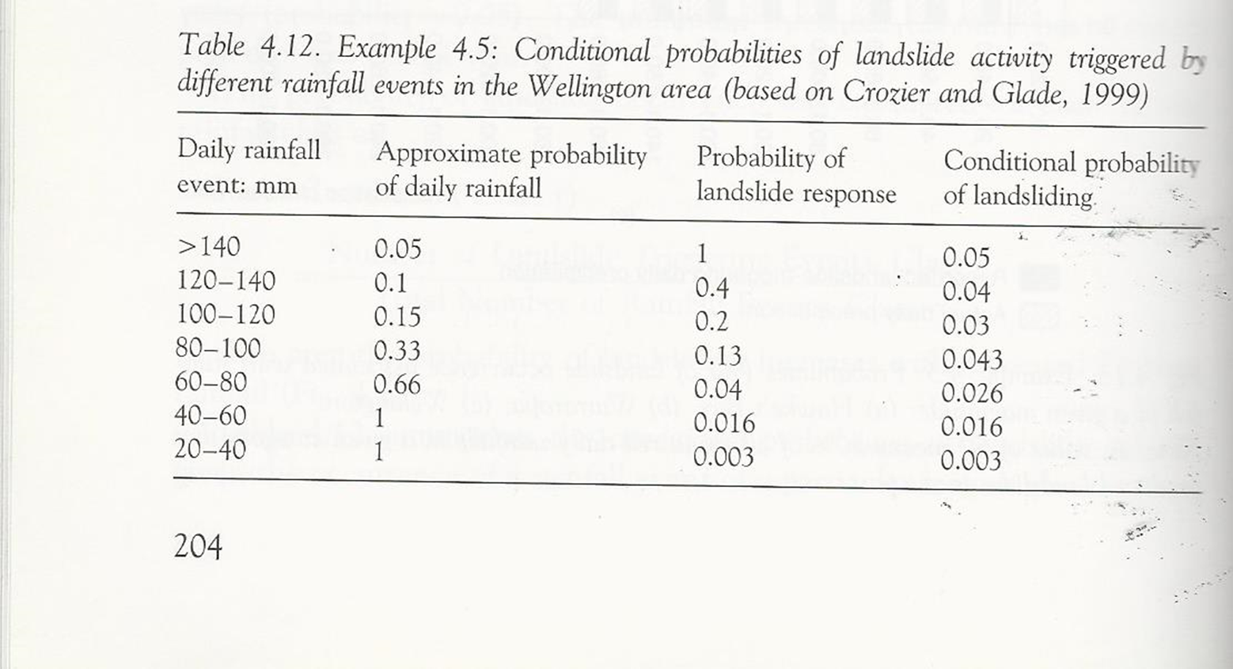
PROBABILITY OF LANDSLIDE TRIGGERED BY RAINFALL FROM NZ DATA –CONDITIONAL PROBABILITY

Slide 47
PROBABILITY BASED ON STABILITY ANALYSIS
PROBABILISTIC STABILITY ANALYSES Performance function Gx = Factor of Safety – 1
Gx > 0 “safe”
Gx < 0 Unsafe of failure
RELIABILITY index (β) = Mean Gx / (Standard deviation of Gx) = Mean ( FS -1 ) / (Standard deviation of FS)
For normal distribution Probability of failure = ψ (-β) = cumulative standard normal distribution at -β

Slide 48
PROBABILITY BASED ON STABILITY ANALYSIS
50 iterations of stability analysis (circular mechanism) using different combinations of input parameters – strength, weight, water levels, etc (or use Monte Carlo for continuous probability distribution and sampling)
“Best estimate” that which corresponds with mean slope conditions
Lower bound estimate based on assumed combination of input parameters believed to correspond to worse case scenario
Upper bound estimate based on assumed combinations of inut parameters believed to correspond to “best case” scenario
For each run, obtain critical FS.
Results give mean FS of 1.21 (say) with standard deviation of 0.08 (say)

Slide 49
PROBABILITY BASED ON STABILITY ANALYSIS
Calculate reliability index β= (Mean Factor of Safety -1)/Standard deviation of FS
β= 0.21/0.08 β=2.62 Probability of failure = cumulative normal standard deviation (ψ (β))
In EXCEL built in function NORMSDIST(-β) to get Pr=4.3 x 10-3

Slide 51
CONSEQUENCE ANALYSIS
Four main groups: (i) Loss of life, injury and impairment of persons; (ii) Destruction of property, resources and heritage; (iii) Disruption of activities, denial of supplies and services (iv) Cultural, spiritual and ethical violations Australian Guidelines that consequence not only property damage and injury/loss of life. Other Consequences include:
(i) Public outrage (ii) Political effects – find a scapegoat (iii) Effect on reputation (iv) consequential costs, such as litigation

Slide 52
CONSEQUENCE ANALYSIS
ELEMENTS AT RISK
EXPOSURE (TEMPORAL PROBABILITY)
LANDSLIDE INTENSITY
VULNERABILITY
DAMAGE AND DEATHS DUE TO LANDSLIDE

Slide 53
ELEMENTS AT RISK
Property which may be subdivided into portions relative to the hazard being considered
People, who either live, work, or may spend some time in the area affected by landslide
Roads and communication facilities
Vehicles on roads,
Permanent – fixed assets
Temporary – degree of risk varies with timing of the event - time of landslide impacting an residential block – night or day (Occupancy)
- A car or train passing a rock cutting when rock fall occurs

Slide 54
EXPOSURE ( SPATIAL & TEMPORAL PROBABILITY)
Exposure is about being at the wrong place (spatial probability) at the wrong time (temporal probability)

Slide 55
EXAMPLE 1 EXPOSURE
500 m Long seaside promenade below a cliff that is affected by rock falls (5m wide). Frequency of rock fall is one (1) per year
Proportion of promenade affected by danger zone = size of rock fall/ length of promenade = 5/500 = 0.01 = 10⁻² Proportion of time that an individual walking at 2.5 km/hour spends on the promenade = Occupancy = Length of promenade / Speed (m/hour) = 500/2500 = 0.2 hours = 0.2/(365 x 24) = 2.28 x 10⁻⁵ years

Slide 56
Example 1 EXPOSURE
Prob ( wrong place and wrong time) = DANGER ZONE (SPATIAL) X OCCUPANCY (TEMPORAL)
=10⁻² x 2.28X10⁻⁵ = 2.28 x 10⁻⁷
Rock fall is once a year. ANNUAL PROBABILITY OF ROCK FALL = 1
ANNUAL PROBABILITY OF AN INDIVIDUAL BEING HIT BY ROCK = 1 X 2.28 x 10⁻⁷
⁼ 2.28 x 10⁻⁷

Slide 57
EXAMPLE 2 VEHICLE EXPOSURE
1 KM WIDE LANDSLIDE AREA. 30 KM PER HOUR
Vehicle exposure = Journey time though exposed area /24 = 0.033/24 = 0.001 389 (DAYS) = 0.001389 / 365 = 3.8 X 10⁻⁶ YEARS
If DAILY 1000 vehicles cross the landslide area with occupancy of 1.5 persons
Exposure = (No vehicles / year) x (vehicle exposure) x (average occupancy) = (1000 x 365) x 3.8 x 10⁻⁶ x 1.5 = 2.08 Equivalent to 2.08 persons for 100 % of the time

Slide 58
Example 3. Residents Apartment block exposure
1000 persons occupancy at different times of day range from 25% TO 95% at night.
Time hours | % population
0 -06 | 0.95
06-09 | 0.75
09-12 | 0.5
12-15 | 0.5
15-18 | 0.25
18-21 | 0.75
21-24 | 0.9

Slide 59
Example 3 Residents apartment block exposure
Equivalent persons
1000 x (0.9375 x 37.5% +0.75*25% + 0.5 x 25% + 0.25x12.5%) = 695
695 persons exposed for 100% of the time
Or 1000 persons exposed 0.695 percent of the time

Slide 60
VULNERABILITY
Timmerman (1981) Vulnerability is the degree to which a system, or part of a system, may react adversely to the occurrence of a hazardous event.
Fell (1994)
Vulnerability … level of potential damage, or degree of loss of a particular asset on a scale of 1 to 10 (VULNERABILITY INDEX), when subject to landslide of a particular intensity

Slide 61
DETERMINATION OF VULNERABILITY INDEX - PROPERTY
LAND SLIDE INTENSITY
Light / Medium / High / Very high
TYPE OF LANDSLIDE Rock fall / Debris Flow / Slide
DAMAGE CLASSIFICATION Superficial / Functional / Structural
DAMAGE GRADE
VULNERABILITY INDEX

Slide 62
LANDSLIDE INTENSITY
Measure of destructive power of landslide
Function of volume and speed
Velocity is key factor in the destructiveness of landslide. Important limit is 5 m/ sec – approximately the speed of a person running away from a landslide

Slide 63
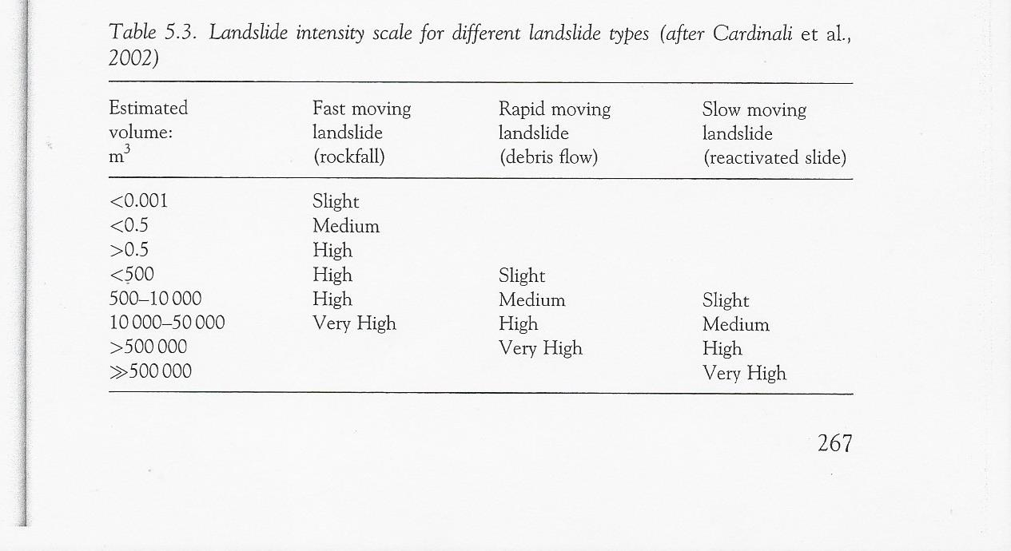
Landslide intensity
Tanjung Bungah

Slide 64
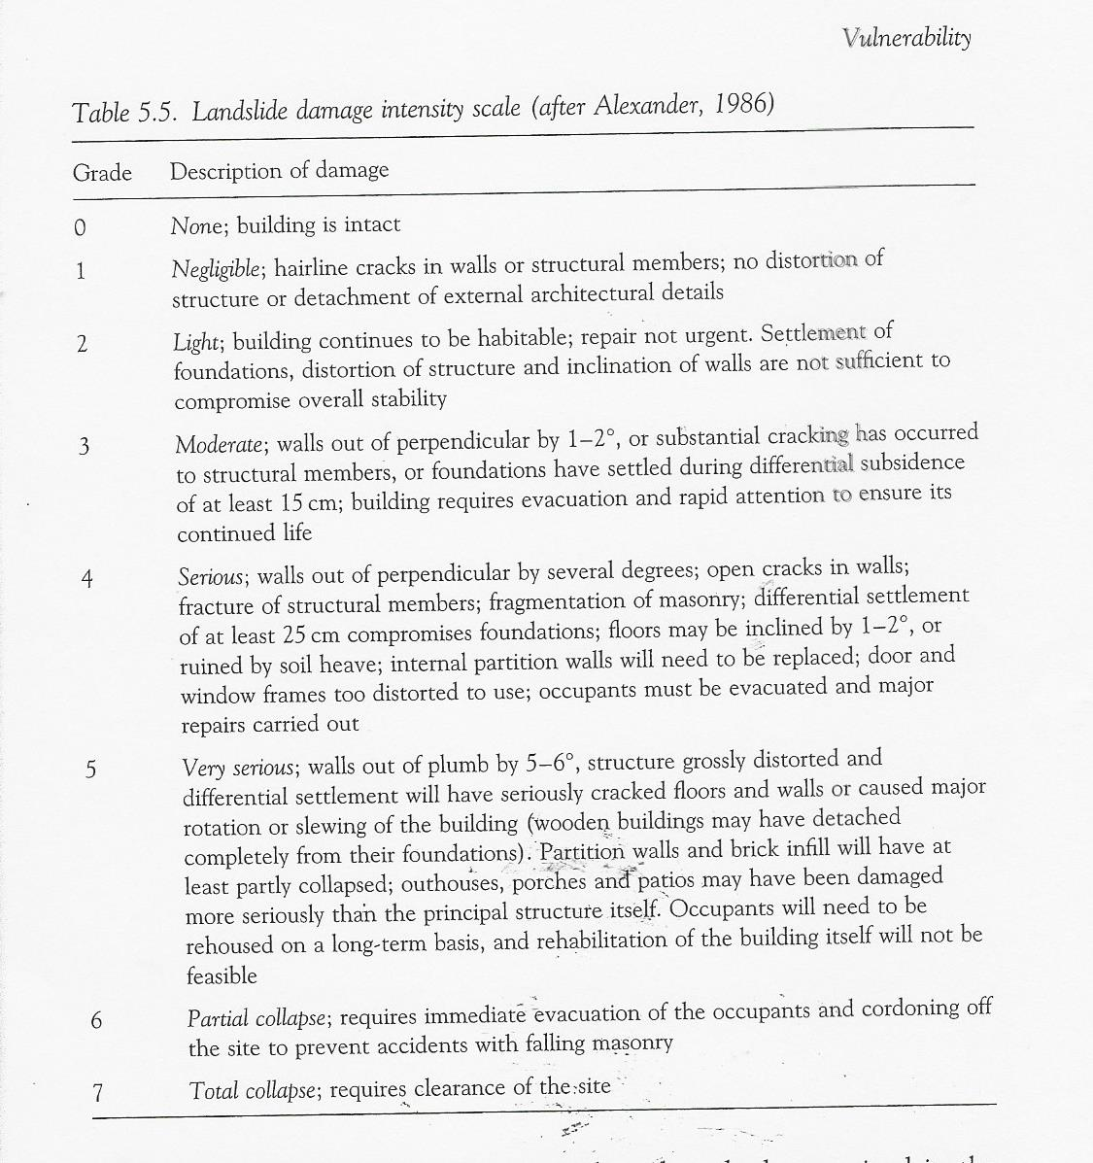
DAMAGE TO STRUCTURES
Damage intensity scale
0 - 1 superficial / COSMETIC. FUNCTIONALITY OF STRUCTURE & INFRA NOT COMPROMISED
2 – 3 Functional MEDIUM DAMAGE. FUNCTIONALITY COMPROMISED. REPAIRS TAKE TIME.
4 – 7 Structural OR SEVERE. BADLY DAMAGED, DESTROYED

Slide 65
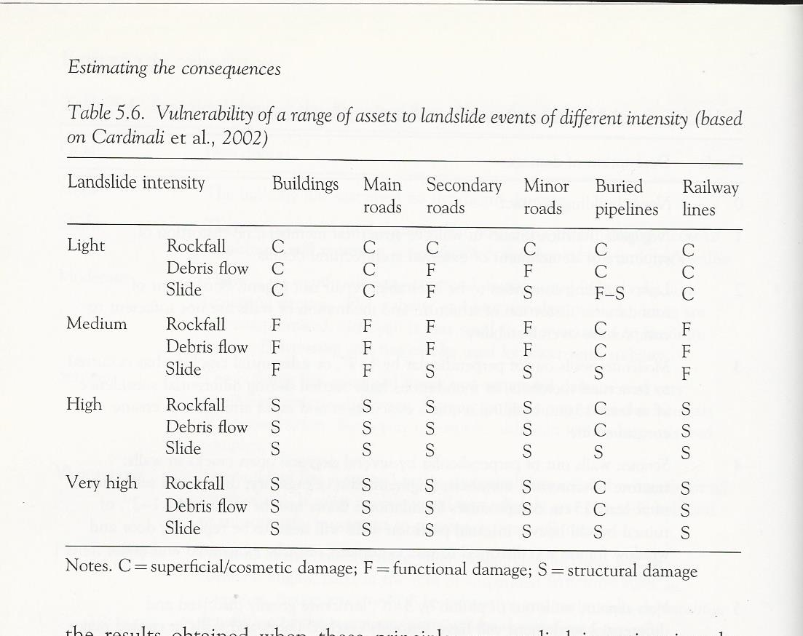
VULNERABILITY OF ASSETS
TO DIFFERENT
LANDSLIDE INTENSITY
C = SUPPERFICIAL, COSMETIC 0 and 1
F = FUNCTIONAL 2, 3
S = DAMAGE 4 TO 7

Slide 66
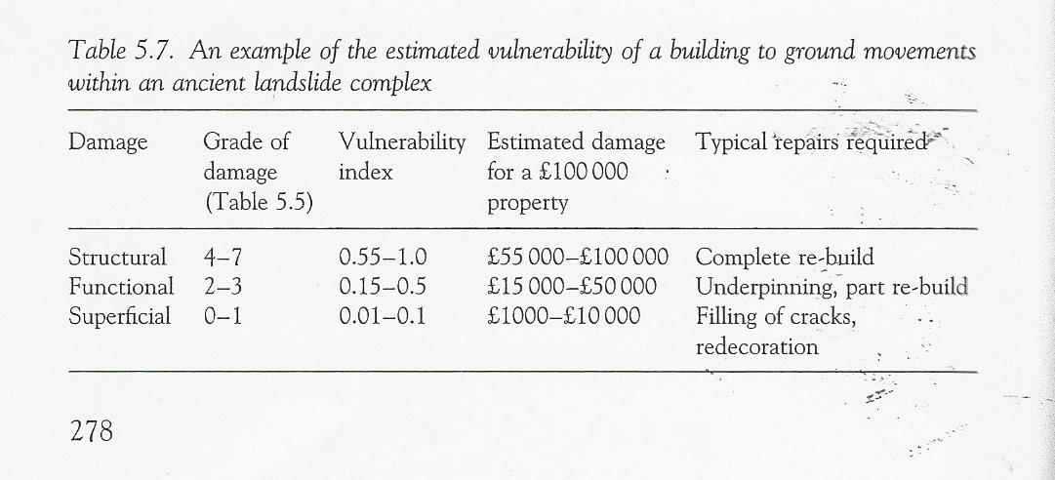
DAMAGE GRADE to VULNERABILITY INDEX

Slide 67
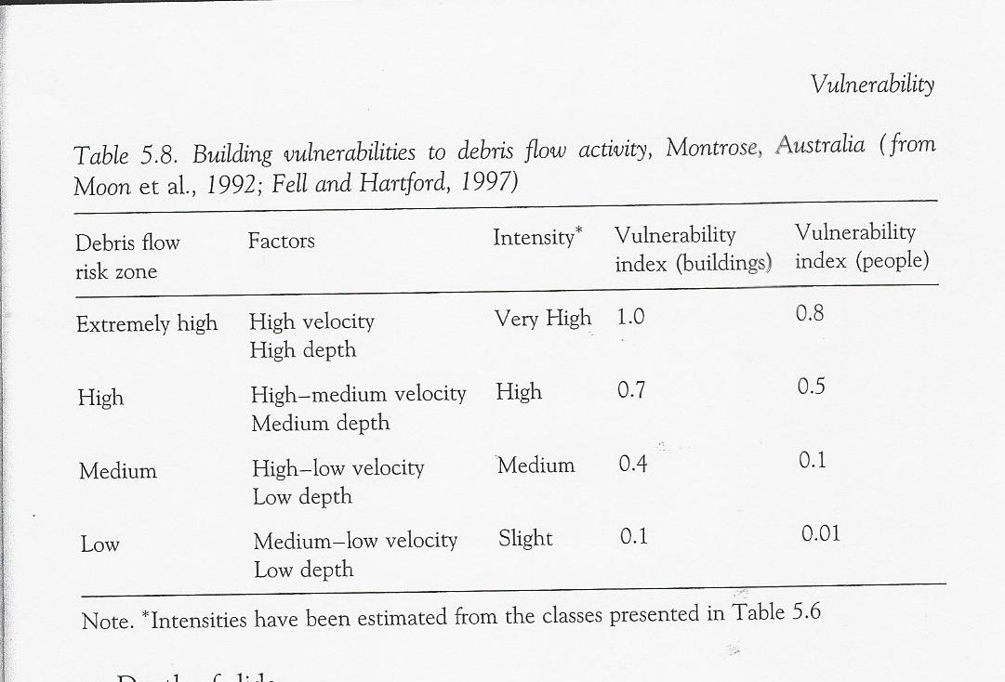
INTENSITY to VULNERABILITY INDEX (BUILDINGS AND PEOPLE

Slide 68
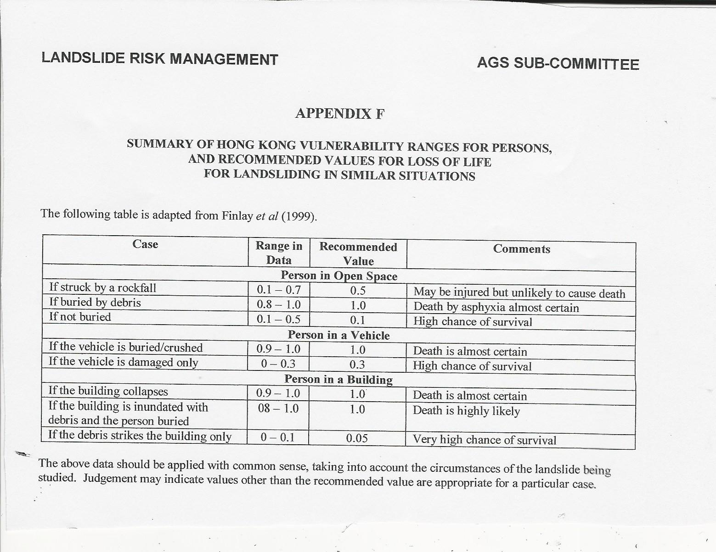
VULNERABILITY TO PERSONS

Slide 69
DATA RELATING LANDSLIDES TO VULNERABILITY OF PERSONS (DEATHS) from FINLAY PhD (UNSW)

Slide 70
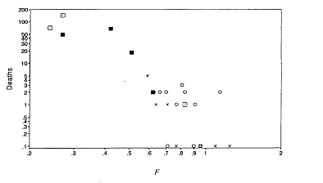
DEATHS VERSUS TRAVEL DISTANCE (H/L)
Short travel distance
TJ BUNGAH
Long travel distance

Slide 71
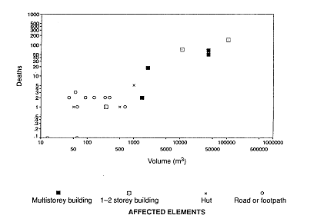
Deaths versus Volume
Small slides < 100 cu m can cause 1 to 2 deaths
Large number of deaths when Volume > 1000 cu m
TANJUNG BUNGAH

Slide 72
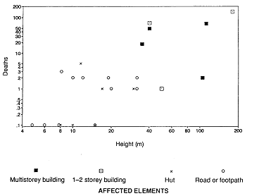
Deaths versus slope height
Number of deaths increase when slope failure height H > 35m
TANJUNG BUNGAH (28M)

Slide 73
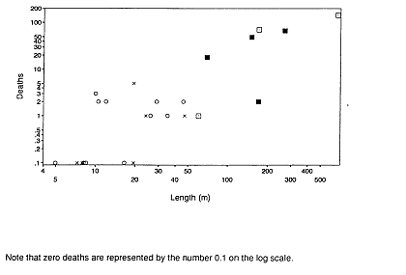
DEATHS VERSUS TRAVEL DISTANCE
Number of deaths increases when runoff distance L > 60m
TANJUNG BUNGAH (60M)

Slide 74
RISK CALCULATION
QUANTITATIVE RISK ASESSMENT
QUALITATIVE RISK ASESMENT

Slide 76
QUANTITATIVE RISK ASSESMENT (PROPERTY)
R_{S} = P (H) X P (S) X V x E
R_{S} = Risk (Annual loss of property value) P(H) = Annual probability of landslide P(S) = Probability of spatial impact by the hazard on the property (landslide impacting property taking into account travel distance. If vehicle take into account temporal probability V = Vulnerability of the property to the spatial impact (Proportion of the property value lost) E = Element at risk (e.g. value or net present value of the property)

Slide 77
QUANTITATIVE RISK ASSESMENT (LIFE)
R = P (H) X P (S) X P(T) x V (D)
R = Risk (Annual probability of loss of life (Death) of an individual P(H) = Annual probability of landslide P(S) = Probability of spatial impact by the hazard on the property taking into account travel distance. P(T) = Temporal probability e.g. of the building being occupied by the individual given the spatial impact V(D) = Vulnerability of the individual (probability of loss of life given the impact)

Slide 78
SEMI QUANTITATIVE AND QUALITATIVE RISK ASSESSMENT FOR PROPERTY
WHEN THE LEVEL OF RISK DOES NOT JUSTIFY THE TIME AND EFFORT REQUIRED FOR MORE DETAILED ANALYSIS
WHEN THE POSSIBILITY OF OBTAINING NUMERICAL DATA IS LIMITED SUCH THAT A QUANTITATIVE ANALYSIS IS UNLIKELY TO BE MEANINGFUL OR MISLEADING
APPENDIX G OF AUSTRALIAN GUIDELINES

Slide 79
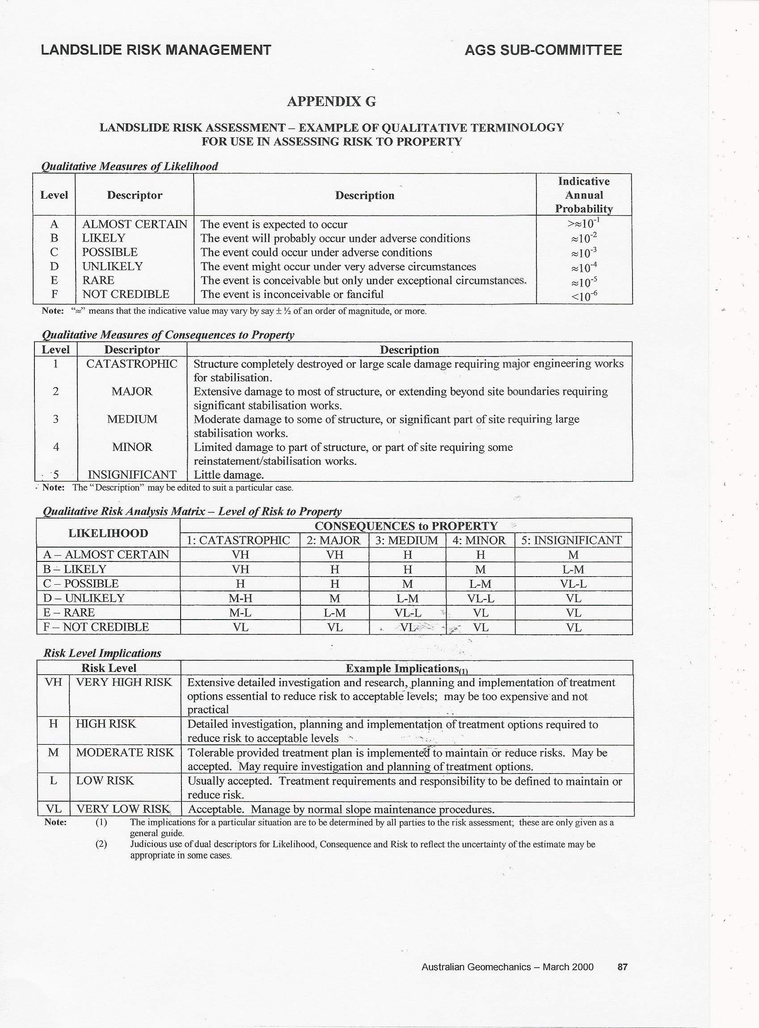

Slide 80
RISK EVALUATION

Slide 82
RISK EVALUATION
COMPARE WITH TOLERABLE AND ACCEPTABLE RISK LEVELS
CLIENT / OWNER / REGULATOR TO ACCEPT OR TREAT
ACCEPTABLE AND TOLERABLE RISKS FOR PROPERTY MUST BE DETERMINED BY CLIENT, OWNER

Slide 83
RISK OF LOSS OF LIFE
IMPORTANT FIRST STAGE IS TO IDENTIFY IF LOSS OF LIFE IS AN ISSUE.
RISK OF LOSS OF LIFE SHOULD BE QUANTIFIED BECAUSE THERE EXISTS RISK ACCEPTANCE CRITERIA
APPENDIX G OF AUSTRALIAN GUIDELINES CONTAIN ANNUAL PROBABILTIES FOR LIKELIHOOD TERMS
DECISION ON RISK ACCEPTABILITY MUST BE MADE BY OWNER, REGULATOR

Slide 84
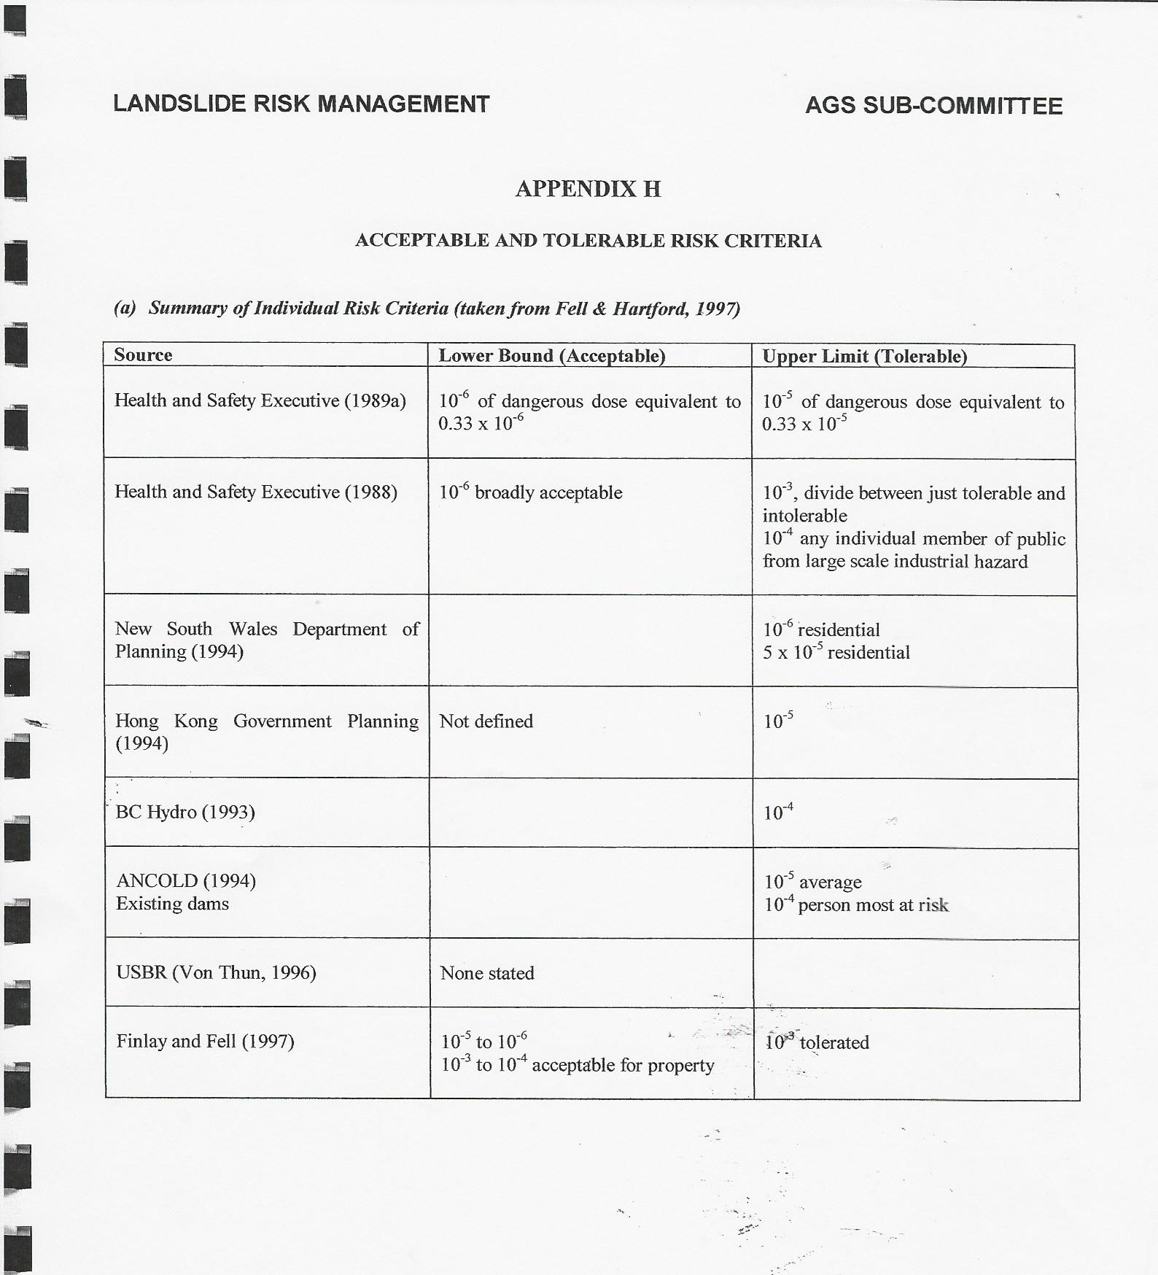
ACCEPTABLE AND TOLERABLE RISKS

Slide 85
RISK TREATMENT

Slide 87
RISK TREATMENT
Australian Guidelines “….. Up to Client or policy maker to decide whether to accept the risk or not….”
“ The landslide risk analyst ….. Should not be making the decision….

Slide 88
TREATMENT OPTIONS
Accept the risk – Usually requires that the risk to be within acceptable or tolerable range.
Avoid the risk – Abandon project. Seek alternative site. Change form of development.
Reduce the likelihood - Stabilization measures Reduce the consequence – Stabilization, relocation of the development
Monitoring and warning system.
Transfer the risk. Someone else takes the risk. Insurance.

Slide 89
UNCERTAINIES / VAGUENESS/JUDGEMENT
IF ALL POSSIBLE OUTCOMES OF AN EVENT ARE KNOWN THEN THE COMPUTATION OF RISK WOULD APPEAR TO BE RELATIVELY STRAIGHT FORWARD
HOWEVER IT IS NORMAL FOR THERE TO BE LACK OF CERTAINTY REGARDING THE FULL RANGE OF POSSIBLE OUTCOMES. LACK OF DATA.
CALCULATIONS OF RISK WILL ALTHOUGH BE OF VALUE WILL BECOME MORE VAGUE AS THE LEVELS OF UNCERTAINTY RISES.
EVEN IF EXTENSIVE INVESTIGATIONS IS CARRIED OUT, ASSESSING PROBABILITY OF LANDSLIDING (PARTICULARLY FOR UNFAILED NATURAL SLOPE) IS DIFFICULT AND INVOLVES MUCH UNCERTAINTY AND JUDGEMENT

Slide 90
THANK YOU

